Slide 1
This is NashTech

Slide 2




Part of Harvey Nash Group
Established
1988
+£1bn
turnover
Technology Recruitment
Leadership recruitment
Tech expert recruitment
Solutions
IT Solutions
Software Development
Technology Advisory
Business Process Management
Leadership Services
Executive Search & interim
Assessment services
Leadership & Board development
36
locations

Slide 3

Our DNA
Technology changes rapidly and transforms everything it touches.
At NashTech, we encourage every employee to think creatively, drive initiatives and take everything from good to great.

Slide 4

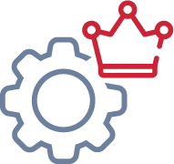

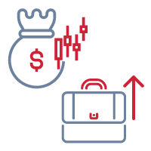
Why NashTech
TRUST
HIGH QUALITY OUTCOMES
Contracting with UK company who has brand, assets and recruitment relations at risk
Strong governance – robust IP and data protection
CMMi level 5 certification
20 years delivering full life cycle enterprise solutions to the international market
Unparalleled quality of engineering and great teamwork
RIGHT PLACE RIGHT TIME
EASY TO BUY FROM AND EASY TO WORK WITH
Vietnam is an outstanding place to find high quality, energetic and enthusiastic talent
The brightest minds seek careers in IT
2,000 employees; operational JVs provide access to much larger pool of resource
Unbeatable value for money
Flexible and scalable engagement models
Reliable, trusted delivery partner with demonstrable long term relationships

Slide 5
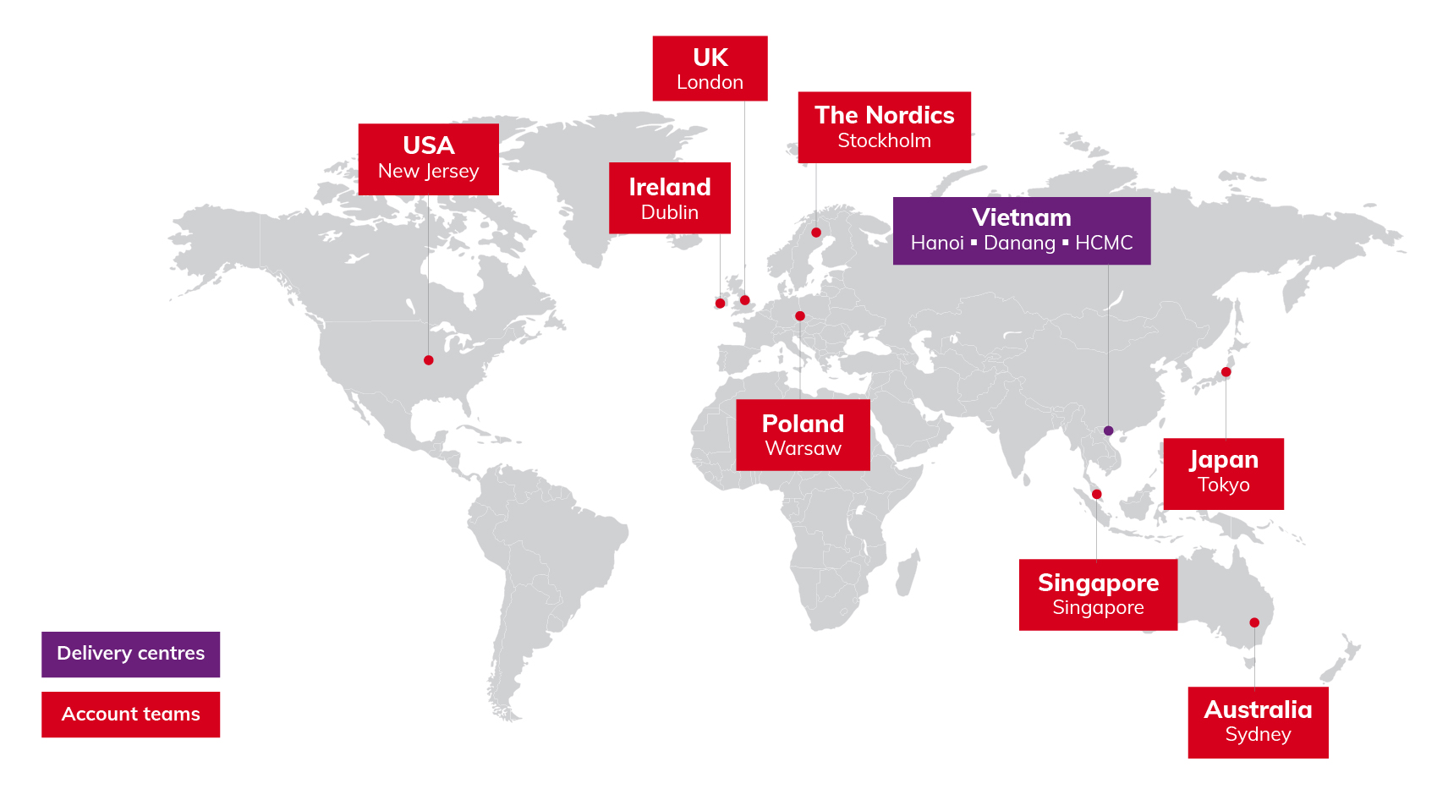
Where we operate

Slide 6
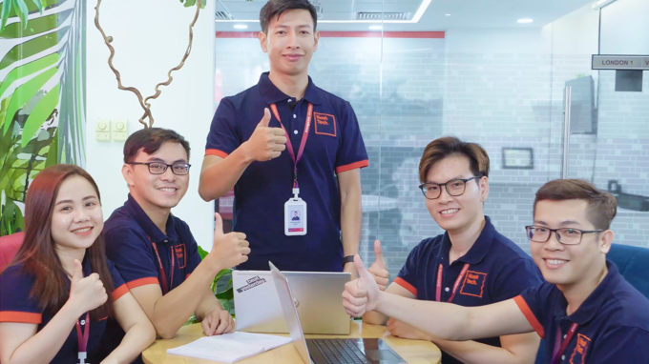

Slide 7

What we do
Software development
Business process management
Technology advisory
Transformative technology delivered with agility
Streamline processes and deliver exceptional outcomes
Shaping technology strategy

Slide 8
What are we known for
Data solutions and services (AI/ML, Data Analysis, Data Planning & Management & Deployment, On-Premise & Cloud based data solutions)“
Our business intelligence specialists, data analysts and data scientists support businesses across the complete data lifecycle – whether that’s managing data inputs, data acquisition, storage, migration of data to the cloud, reporting and visualisation, or predictive analytics.
Business Automation
Our team helps clients across the world by delivering targeted automation that transforms the business, with above 98% accuracy for even the most complex tasks, and with cost reductions commonly between 30-50%.
User experience and content management services
Businesses need to be able to design, track and analyse user journeys through their digital channels and capture key
information on their interactions with content across formats, so that engagement and value can be enhanced.
Technology advisory
We bring independent advice and guidance to businesses, helping them analyse their technology position in relation to strategic ambitions. Our teams of highly experienced consultants and subject experts help clients see the bigger picture, from end to end, and provide clarity over the shape and scope of the journey ahead.
Full stack custom development
We have been designing, testing and implementing bespoke software solutions for businesses across many sectors for over 20 years. We help clients through the complete software lifecycle, from business requirements, capture, design and development, through to maintenance and enhancement. We are highly adaptive with a flexible agile approach, pride ourselves on high quality and security and adopt a continuous delivery culture
Maintaining and supporting software applications
In the digital age, no organisation can afford for its systems or services to become ineffective or unavailable so our team of 120 specialists offer a flexible and bespoke service to keeping you up and running.
Independent testing
Through the combination of over 300 skilled resources, automation tools and effective test management processes, we offer a new and flexible standard in software testing.
Robust governance
Our quality management system underpins everything that we do. Our quality assurance service provides end-to-end support across the entire software lifecycle and at all stages of development, from concept to release and beyond.

Slide 9









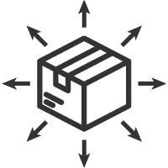

Making it happen - sector focus x geography
Sector* |  | UK & Europe | USA | Vietnam | Australia | Singapore | Japan
 | Financial services
 | Media & tech
 | Education
 | Healthcare
 | Manufacturing
 | Consumer
 | Logistics
 | Professional services
* We're collaborating with clients across the Harvey Nash Group (see: group brand logos)

Slide 10
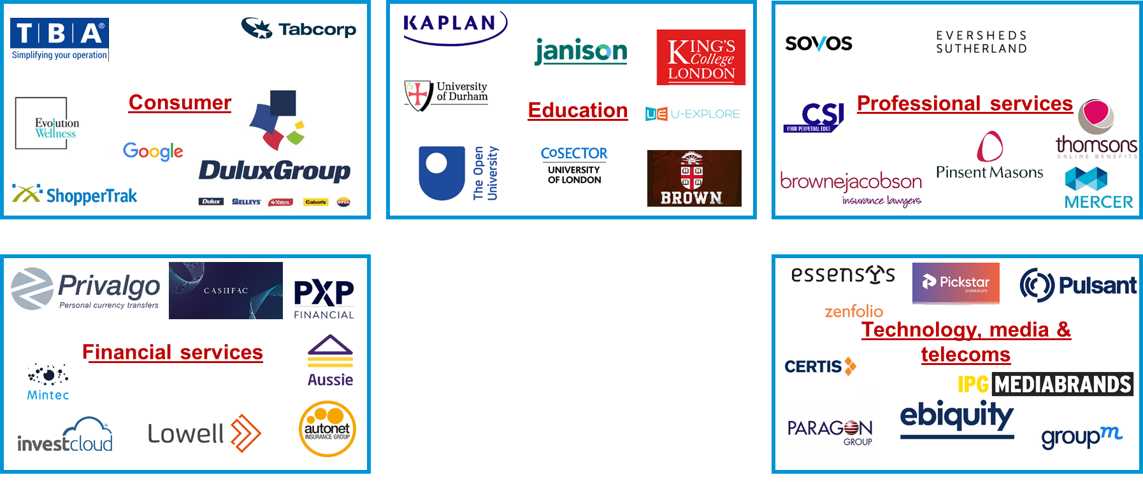
Sector footprint – some of our clients

Slide 11





Research and development
StepOne
Internet of Things
RPA
Common libraries, components to be able to reuse in many projects. Languages: C#, JS, PHP, …
Smart bands, Smart Watches, Smart City, …
Virtual Assistant
Data Science
Chat bot, Voice Service on Microsoft Bot Framework, AWS Alexa Services …
Big Data, Data Analytics, Machine Learning, Deep Learning, Recommendation,, Prediction, …
Blockchain
Robotics Process Automation
Investigating Blockchain, Ethereum, Smart Contracts, HyperLedger, …
RPA
Not just leveraging existing tools such as UiPath, AAA, BluePrism to automate processes, but also building the tool for specific business needs ...

Slide 12
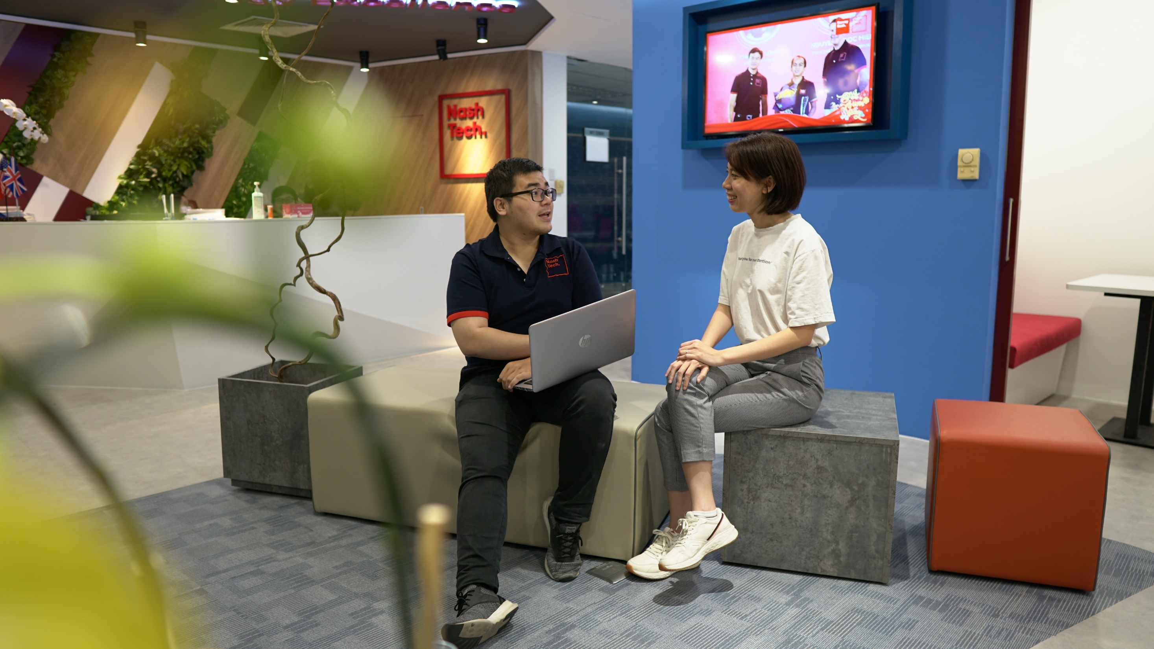

Slide 13
“Creating the best solutions,
powered by our excellence in people and technology”
Notes:
Our mission is to create the best solutions powered by our people and technology excellence.

Slide 14
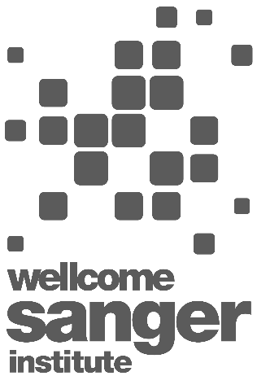
The challenge
“It has been a real pleasure working with NashTech. They took the time to collaborate with the team and understand what we needed, fully documenting processes and creating a detailed solutions architecture. There is no way we could have scaled to where we are, in the accelerated timescale it’s been achieved, without NashTech.”
Under its Tree of Life programme, the Wellcome Sanger Institute is leading the initiative to decipher the genomes of 72,000 living organisms found in Britain and Ireland.
Rather than depending on manual spreadsheets and processes to record and track samples, the Institute needed a software system that would enable them to efficiently, quickly and effectively manage the journey of each and every sample through the process, giving team members across different departments access to up-to-date and real-time information whenever they need it.
Health & Life Sciences
The solution
We have delivered a bespoke software solution to the Institute which enables team members to track every single sample received on an end-to-end basis.
Hosted in a private cloud, there is a single user interface. Written in Open Source code (Python), the open API used means that the system is easy to maintain, fully scalable and can be securely connected to the wider European and rest of the world databases as they are developed under the programme.
Software development
Open source code (Python)
Kenneth Haug
Enabling Platforms Team Lead - System Owner
The Wellcome Sanger Institute is a world leader in genome research that delivers insights into human and pathogen biology that change science and medicine. It is sited on the Wellcome Genome Campus in Cambridgeshire at the heart of a global hub of fundamental and applied genomic research.
The outcomes
The speed, efficiency and accuracy of the project has been significantly increased and samples, along with their meta data, can be logged and recorded in much less time than previously.
There is much less room for error or inaccuracy now that manual processes and data entry have been removed. The Institute has a system that can easily be configured to other projects too – thus representing a strong return on investment.

Slide 15







The challenge
Atlanta needed to develop and deploy a digital strategy to help drive value from their business strategy.
“I am delighted by all that has been delivered and how NashTech, my internal teams and our other business partners have collaborated to deliver on our digital strategy. We have recently committed to a long term partnership with NashTech. We see this as an extension to the relationship and our own Atlanta digital capabilities, expanding our engagement into other technical areas where we can capitalise on their expertise.”
The approach & solution
NashTech initially focused on the digital elements of the CSP which needed to seamlessly support the integration of new insurance acquisitions as well as support organic business growth. The key deliverable for the initial project was the application infrastructure which underpins the digital development. This was soon followed by multiple deliveries for major product lines.
Atlanta have developed a common systems platform (CSP) enabling competitive advantage through digital trading with customers and partners, efficient core administration processing, and timely and comprehensive data insight and analytics.
Financial services
Software development
.Net MVC
James Fairhurst
Results and benefits
Chief Information Officer
The Atlanta Group is one of the largest and fastest-growing brokers in the UK insurance market. Made up of multi-brand personal lines digital platforms, and leveraging advanced consumer data and pricing analytics, they have secured their position as the industry leading digital broker.
Atlanta incorporates the well-known and much respected Swinton, Autonet and Carole Nash brands. They are part of the worldwide Ardonagh Group which is the largest independent insurance broker in the UK and a top 20 broker globally.
The new Atlanta ‘quote and buy’ sales platform has yielded an impressive set of business ratios over the old sites on a like-for-like basis:
Journey completions are up by more than 47%
65% more customers who start the journey now quote
Quote to sale ratios are up 226%
Cost per quote is 26% of what it was previously

Slide 16
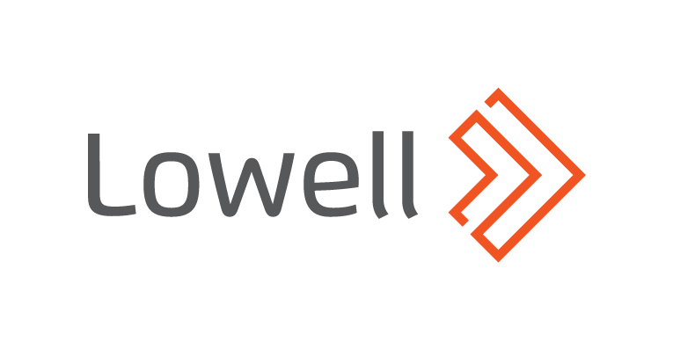
The challenge
“NashTech was the key partner for us in building a modern target architecture. Within a short time, we established a platform in the cloud that is connected to our legacy world, both technically and process-wise. Containerization, continuous deployment, microservices approach, DevOps and agile teams are just a few results of the fabulous collaboration. Together with NashTech, we have poured the foundation for the future.“
Lowell had acquired a set of businesses in the DACH region, each with a unique collection of 3rd party business systems and faced the challenge of consolidating them to deliver consistency, flexibility and cost savings
In 2018 they started to look for an offshore development partner who could scale with their growth ambitions whilst meeting their exacting quality and data security standards, and at a reasonable price
Financial Services
The solution
The legacy 3rd party “receivables management” systems were wrapped in an adapter to de-couple them from the new core platform
The delivery approach focused on a consumer facing portal, then electronic interfaces to the German court network and EU-GDPR compliant processing of personal data to meet legislative deadlines, then on both internal customer user interfaces and client facing portals
Software development
.Net CORE, Microservices Architecture and Azure
Lars Werbeck
Results and benefits
Head of IT Solution DACH / Lowell Service Center GmbH
Lowell is a leading and fast growing credit management services group based in Europe. It has a top three position in the UK and Germany, the two largest consumer credit markets in Europe. Lowell was acquired by Permira in 2015.
The initial POC was rapidly put into production and provided the customer’s first consumer facing responsive website that included features such as accepting online consumer payments.
The programme has provided the customer with a firm foundation for their core systems from they continue to build. The software IP is owned by the customer and they can reduce their reliance and spend with 3rd party provided as a result.

Slide 17

The challenge
This global business services organisation had grown through acquisition and found itself with a business critical applications portfolio that was costing a lot and leaving few resources to focus on innovation and growth. The organisation had experienced traditional offshore delivery and needed a partner who they could depend upon and trust to deliver.
The solution
Supply chain management
The objective was to replace around 30 legacy applications with a single technology platform with interfaces into the systems of record.
End to end software development
.Net
The outcome
Over two years NashTech’s scrum teams have completed some +50 sprints to deliver the solution over 20 increments.
The key metrics have demonstrated a continuous improvement in team sprint velocities as well as consistently high quality supported by test automation.
NashTech’s teams have worked highly collaboratively with both the client’s global teams and other delivery partners. Excellent communications and team morale has supported very low turnover during the entire project.
The new platform has already demonstrated significant operational costs savings as well as providing the flexibility to support international growth and new business models.
Our client collects and validates supplier data and mitigates risks globally. This data-driven insight builds more secure, sustainable, better performing supply chains.

Slide 18
The challenge
Our client had developed a wearable patch with a US vendor that monitored data such as heart rate and blood oxygen levels. This needed to be streamlined and integrated with an iOS remote monitoring platform
The approach and solution
We removed the gateway device that connected to the patch and merged the tablet and phone app together, placing all communications and functionalities into one platform. A code base was created on Xamarin that would be more compatible with any future patches or devices and the app infrastructure was migrated from on premise to AWS cloud
We changed the timing of data capture so that it was collected incrementally, but still often enough to gain relevant insight, and we moved all the queuing services to the cloud
A monitoring system suitable for services such as elderly and post op care, helping healthcare practitioners, intervention centres and even family members to monitor patients remotely. This allowed users to view multiple patients’ data in real time and receive alerts in emergencies.
An iPad and web app with two-way video calling, allowing triage units to check on nursing home residents and giving patients the option to contact a professional when they are not feeling well. The provider can view patient history and has the option to escalate the case and transfer the patient data to a doctor. A phone app for clinicians followed, allowing them to be mobile.
Healthcare
Software development
Angular, Nodejs, Seneca framework
A concierge medicine that utilises state-of-the-art technology to empower patients to receive the care they need in the comfort of their home. It provides unparalleled and hassle-free access to a physician with no co-pay or deductible.
The results and benefits
Hospital readmission rate was reduced from approximately 20% to 5%, relieving the strain on emergency rooms and doctor’s offices, and reducing costs for both healthcare providers and the government. Heart attacks were able to be identified and prevented, providing faster care, and ultimately saving lives. During the pandemic, it helped to reduce the risk of exposure for vulnerable patients and allowed those diagnosed to recover and be monitored from their homes. It also identified COVID-19 cases through skin temperature.

Slide 19

The challenge
The existing NSK ERP system had been implemented in Japan for the Japanese market and when compared with the requirements for the European business had a 40% delta
NSK conducted a competitive tender to select a supplier to implement the required enhancements to the system
“Working with Vietnam has been a real pleasure and experience. Vietnam doesn’t feel like an offshore destination – the team work as one.
It has been comforting to know that when you have you back to the wall, as you do with a project this size, NashTech are standing there beside us not walking away… they are a true partner.”
Manufacturing
The approach and solution
NashTech organised and conducted a series of workshops with NSK staff to capture detailed requirements for the necessary enhancements, grouped the requirements into delivery phases, created design documents and then executed a series of projects to build and release to NSK for user acceptance testing (UAT)
NashTech extended the core implementation from the Japanese version to meet the European requirements whilst ensuring that the core requirements between the two systems were common.
Software development
Java, J2EE, Oracle database
Tony Doran
The benefits
NSK European IS Director
One of the world’s leading manufacturers of rolling bearings, linear technology, automotive components & steering systems with 30,000+ employees around the world and $7billion turnover.
14 month programme delivered within two weeks for committed timescale with very few production issues
System implemented now supports NSK Japan, UK, Europe and South Africa

Slide 20

The challenge
“NashTech currently provides IT development for the site, which hosts over 15,000 free courses, videos and educational interactives and which reaches over 8.5m people a year.
NashTech’s involvement has been critical to delivering robust development deploys for the last two years, its offshore team going the extra mile when needed. They are the hidden, but vital, element to a smooth-running platform that showcases the very best of Open University teaching to the world.”
Operating at scale presented a number of IT challenges which included mobile compatibility across all operating systems, OpenLearn platform and page loading times, maintaining business continuity for both staff and students, and ensuring GDPR compliance of all personal data.
Having had multiple suppliers in the past also caused inconsistencies in workflow processes and produced conflicting coding practices. The Open University needed to address these challenges while keeping site downtime to a minimum.
Education
The solution
Software development
We delivered to a phased implementation plan over a six month period to minimise any disruption to the service. With high traffic priority pages and new navigation in place, the next step was to optimise all other pages on the site.
Moodle & Drupal
Dr. Patrina Law
The outcomes
Head of OpenLearn, Open University
Since its launch in 2006, the OpenLearn platform has become an integral part of The Open University, with the site attracting over 8.5 million visitors a year. It hosts nearly 1,000 free courses and more than 11,000 hours of learning content.
OpenLearn was successfully transformed to be optimised for mobile, with an improved user experience, and greater security for all users in 2017.
NashTech continues to work with The Open University, continually improving these capabilities, while adding new features and implementations to enhance the learning experience on the OpenLearn platform.

Slide 21

The challenge
U-Explore needed to get its product to market fast - a new platform for career guidance within an evolving market opportunity, while working within tight budget constraints. They needed to select the right solutions and features without compromising on quality.
U-Explore had also wanted to adopt agile approaches to its application development and depart from their existing burdensome applications, but given their budget constraints, they weren’t sure if this would be possible to achieve.
Education
The solution
NashTech was able to introduce an advanced micro services architecture using agile methodologies and robust engineering principles. They were able to meet all of U-Explore’s objectives by working collaboratively with the product owners, and NashTech built a platform that can be continually developed with new features added as required.
The use of tools such as Jira and Teams plus flexibility to apply different approaches, such as Scrum and Kanban, allowed the company to assess and select different features and thereby maximise the value delivery within their time and budget constraints.
Software development
Microservices architecture
The outcomes
U-Explore is a UK based EdTech company specialising in careers guidance. They aim to ensure that every young person has access to the best information, advice and opportunities that will shape their future, regardless of who or where they are.
Throughout the project engagement, U-Explore identified new target audiences and use cases for the platform. Our governance and adaptable delivery allowed U-Explore to quickly include new features, to help U-Explore assess and decide on the best approach for them and then update the delivery plan.
As well as delivering value early, this has allowed U-Explore to exploit new business opportunities quickly and move towards becoming an agile enterprise.

